Slide 1
Exceptions and assertions

Slide 2
Content
Exceptions basics
Custom exceptions
Multi-catch
Try-with-resources
Suppressed exceptions
Assertions

Slide 3
Exceptions basics
Exceptions occur when the program takes the unhappy path
For example:
Trying to access a resource that is not there
Using an index of an array that doesn’t exist
Calling a method on an object that is a null
Exception is a protocol of what to do when unfortunately the happy path is going wrong
Exceptions can occur due to problems with the code and problems that are beyond the control of a developer

Slide 4
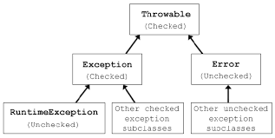
Exceptions hierarchy
Runtime = unchecked
Compile time = checked >> must be handled or declared
Error > not an exception, should not be caught, but can be caught
Notes:
Errors are fatal, there should not be protocols for them, but you could catch them

Slide 5
List of exceptions for OCP
Checked | Unchecked
ParseException | ArithmeticException
IOException | ArrayIndexOutOfBoundsException
FileNotFoundException | ClassCastException
NotSerializableException | IllegalArgumentException
SQLException | NullPointerException
 | NumberFormatException
 | ArrayStoreException
 | DateTimeException
 | MissingResourceException
 | IllegalStateException
 | UnsupportedOperationException

Slide 6
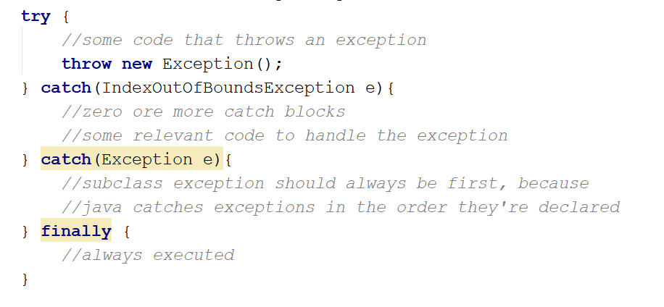
Try statement
Notes:
Try (not the one with resources) must always have a catch or finally associated with it

Slide 7
Will this compile?
try {
//some code that throws an exception
throw new Exception();
} catch(IndexOutOfBoundsException e){
//zero or more catch blocks
//some relevant code to handle the exception
} finally {
//always executed
}
Notes:
No, the exception that is being thrown is never caught

Slide 8
Will this compile?
try {
//some code that throws an exception
} catch(IndexOutOfBoundsException e){
//zero or more catch blocks
//some relevant code to handle the exception
} finally {
//always executed
}
Notes:
Yes, try block doesn’t need to thrown an exception

Slide 9
Will this compile?
try {
//some code that throws an exception
throw new Exception();
}
Notes:
No, try needs at least a catch or a finally

Slide 10
Will this compile?
try {
//some code that throws an exception
} catch(Exception e){
//zero or more catch blocks
//some relevant code to handle the exception
} catch(IndexOutOfBoundsException e) {
//never executed
} finally {
//some other finally code
}
Notes:
No, first catch catches all exceptions and second one gets unreadable

Slide 11
Will this compile?
try {
//some code that throws an exception
} catch(Exception e){
//zero or more catch blocks
//some relevant code to handle the exception
} catch(Exception e) {
} finally {
//some other finally code
}
Notes:
No, you cant catch same exception twice

Slide 12
Will this compile?
try {
//some code that throws an exception
} catch(IndexOutOfBoundsException e){
//zero or more catch blocks
//some relevant code to handle the exception
} finally {
//always executed
} finally {
//some other finally code
}
Notes:
No, you can only have one finally

Slide 13
Throw vs throws
Throw >> used to throw an exception
throw new Exception();
Throws >> used to declare an exception in the method signature
public void throwSomething() throws IOException { // some code that might throw an IOException }
Runtime exceptions don’t need to be caught and therefore don’t need to be declared when they’re not caught

Slide 14
Custom exceptions
Theoretically you can extend any exception class to create your own exception
But it’s common practice to use:
Exception for checked
RuntimeException for unchecked

Slide 15
Example: custom exception
public class CustomException extends Exception {
public CustomException(){
super();
}
public CustomException(Exception e){
super(e);
}
public CustomException(String message){
super(message);
}
}

Slide 16
Exercise: create your own exception class
Create two exceptions, one is checked and one is unchecked
The checked one is thrown by a method in Cat, called catchSpider. This exception is called: UnexpectedStrongSuperSpiderException
The unchecked exception is SpiderAteCatException
Build some context around it so you can test it
Bonus: justify the use of checked and unchecked exceptions for these cases

Slide 17
Multi-catch
You can catch multiple exceptions in the same catch block
This avoids double code
It avoids catching all exceptions as a workaround to not have double code
It avoids hard to read code
try {
//some code that throws an IOexception
} catch(IndexOutOfBoundsException | IOException e){
//some relevant code to handle the exception
}
Variable name should only appear once, and at the end
Exceptions in multi-catch cannot be related to eachother
The exception in the multi-catch block is final, and you’re not allowed to reassign another exception to it
Notes:
Checked exceptions must be possible to be thrown when they are caught

Slide 18
Will this compile?
try {
//some code that throws an IOexception
} catch(IndexOutOfBoundsException | Exception e){
//some relevant code to handle the exception
}
Notes:
No, exceptions are related

Slide 19
Will this compile?
try {
//some code that throws an IOexception
} catch(IndexOutOfBoundsException e1| IOException e2){
//some relevant code to handle the exception
}
Notes:
No, exceptions are named once at the end. Here it’s named twice

Slide 20
Will this compile?
try {
//some code that throws an IOexception
} catch(IndexOutOfBoundsException| IOException e){
//some relevant code to handle the exception
}
Notes:
Yes it does

Slide 21
Will this compile?
try {
// some code that doesn’t throw an exception
} catch(IndexOutOfBoundsException | IOException e){
//some relevant code to handle the exception
}
Notes:
No, IOException is checked, and in order to have a checked exception in a catch, there must be a possibility of this exception being thrown

Slide 22
Will this compile?
try {
//some code that throws an IOexception
} catch(IndexOutOfBoundsException| IOException e){
//some relevant code to handle the exception
e = new IOException();
}
Notes:
No, e is final

Slide 23
Try-with-resources
Resources that are opened in the try need(ed) to be closed in the finally, if they were indeed successfully opened
Since Java 7 this can be written differently, called try-with-resources
The resources opened in the try statement are automatically closed
Resources opened in try(resources) have a scope that is limited to the try block
Resources are closed in the reversed order they were opened

Slide 24
Example: try and try-with-resources
Old way of closing resources in try
New way of closing resources in try
BufferedReader in = null;
BufferedWriter out = null;
try {
//reading from in
//writing to out
} finally {
if(in != null) in.close();
if(out != null) out.close();
}
try(BufferedReader in = Files.newBufferedReadere(path1); BufferedWriter out = Files.newBufferedWriter(path2)) {
//reading and writing
} //<<resources are closed here
//yes, that’s right… Try-with-//resources doesn’t necessarily need //a catch or explicit finally block
Notes:
From the textbook

Slide 25
AutoCloseable
Resources that are used in the try-with-resources must be autocloseable. This means they implement the interface AutoCloseable
This means the method public void close() throws Exception {} must be implemented
Close method should be idempotent >> don’t have side effects, can be called multiple times with same result and no side effects
Better for close method to not throw exception, but to throw a more specific exception

Slide 26
Exercise
Create a class CatHuntAction
The class should be autocloseable
The class should have a Cat and a Spider property
The CatHuntAction logs the action of the cat hunting the spider
In a main method, open the CatHuntAction, and call methods on the specific cat
These methods should be able to throw your custom exceptions, handle them in a proper manner

Slide 27
Suppressed exceptions
When multiple expressions are thrown, only the first one is handled, the others are suppressed
For example: try-with-resources throws an exception in try block, and closing the resources throws another example: only the first one is handled
This only applies to exceptions thrown in try clause, so not in catch or finally
You can get suppressed exceptions in the catch block with e.getSuppressed(). This gives back an iterable which you can loop through

Slide 28
Exercise: suppressed exceptions
Change the try-with-resources from the previous assignment to throw two exceptions in the catch block
Print caught and the suppressed exception

Slide 29
Exception handling do’s
Clean up resources / use try-with-resources
No empty catch blocks
Catch and throw specific exceptions
Add clear descriptions when throwing messages
Don’t ever catch errors (so don’t catch Throwable, becauser errors are a subclass)
Describe usage of exceptions in Javadoc
Additions..?

Slide 30
Assertions
Boolean expression that is used that should be true
Used in non-production code to detect serious problems
Don’t believe it until you see it? >> use an assertion, and then get rid of it again
If an assertion is false, it throws an AssertionError and kills the program
Assert statement: assert boolean-expression: “optional error message”;
Enable assertions, else they’re ignored at runtime: use –ea or –enableassertions on cmd:
Java –ea SomeJavaClassName

Slide 31
Example: assertions
if(true) {
} else {
assert false: “this cannot be reached”; }

Slide 32
Exercise: assertions
Add an assert statement in your application that returns true and that the application will encounter
Run the application with assertions enabled
Bonus: what would have been a better way to do this than with assert?
Notes:
Throw a runtimexceptions is usally better than an assert

